Slide 1
CNN
Convolution neural network

Slide 2
Used for
object recognition,
including image classification,
detection, and segmentation.
Additionally, it is utilized in natural language processing, time series analysis, and speech recognition.

Slide 3
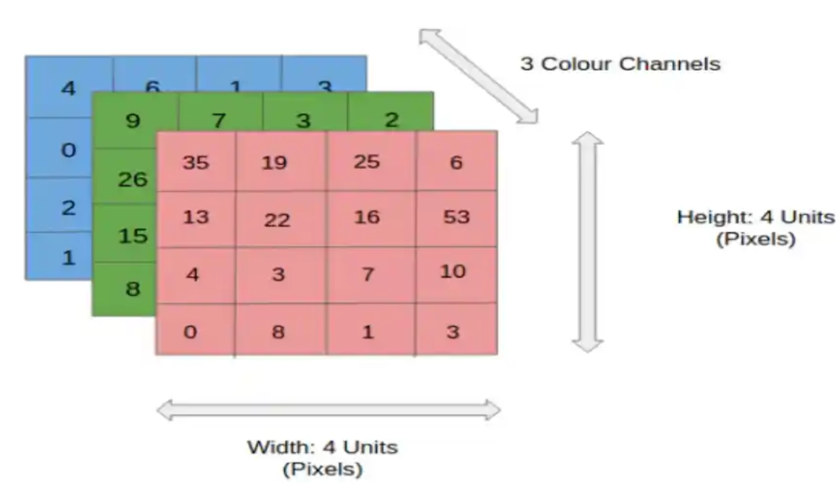

Slide 4
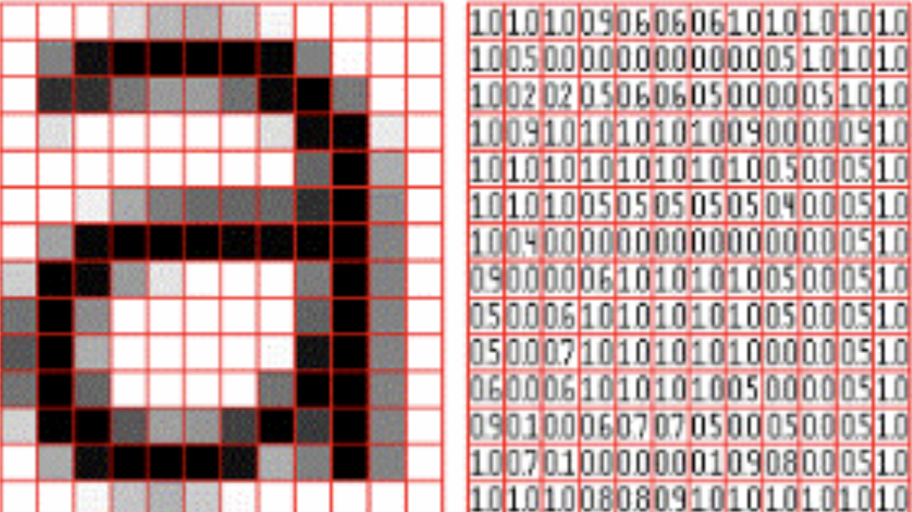
Input image and pixel representation
Source google images

Slide 5
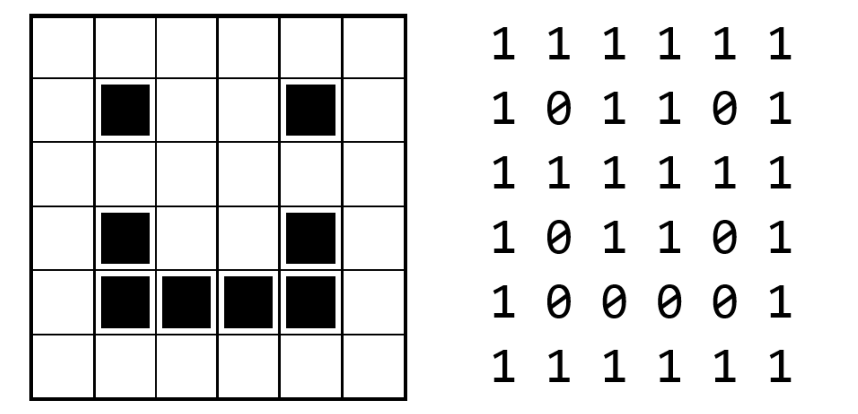
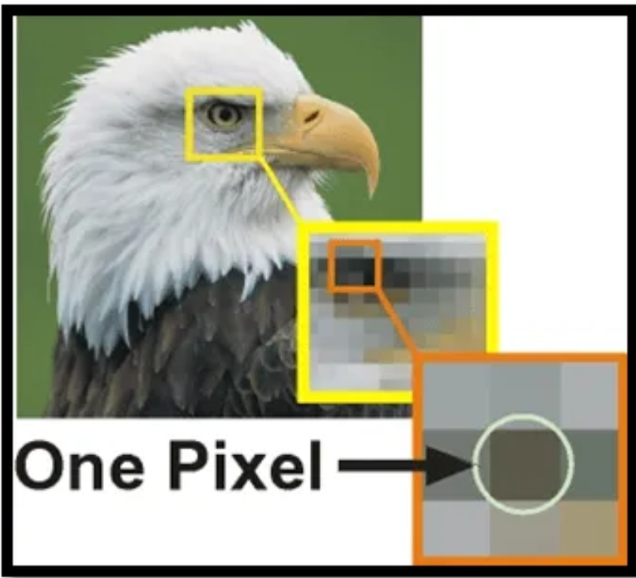
Stored as a binary string of 36 bits
Images can be represented in multiple ways - the most common being as a grid of little squares called pixels. In a very simple image that was only black and white, we could think of each pixel as being represented by a 0 (black) or 1 (white). Source: https://computerscience.chemeketa.edu/cs160Reader/DataRepresentation/ImageRepresentation.html
Digital images are essentially grids of tiny units called pixels. Each pixel represents the smallest unit of an image and holds information about the color and intensity at that point.
Each pixel is composed of three values corresponding to the red, green, and blue (RGB) color channels.
A RGB colour is usually stored as a triplet of integer numbers in the range 0 to 255. (255,0,0) is red - (0,255,0) is green - (0,0,255) is blue: check this tool for understanding: https://www.geogebra.org/m/Dq2A7aRv

Slide 6
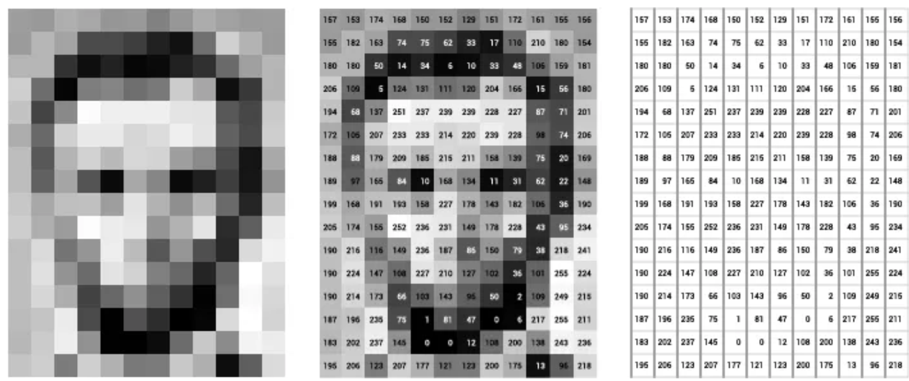
Gray scale image
Each pixel carries a single value that represents the intensity of light at that point. Usually ranging from black (0) to white (255)
Google images
Input layer: Each neuron in the input layer corresponds to one of the input features.
For instance, in an image classification task where the input is a 28 x 28-pixel image, the input layer would have 784 neurons (one for each pixel).
Difference from basic neural network:
Convolution Layers:- They are the fundamental building blocks of CNNs. These layers perform a critical mathematical operation known as convolution.
That involves application of specialized filters known as kernels, that traverse through the input image to learn complex visual patterns

Slide 7
Key Components of a CNN
The convolutional neural network is made of four main parts.
Convolutional layers
Rectified Linear Unit (ReLU for short)
Pooling layers
Fully connected layers
They help the CNNs mimic how the human brain operates to recognize patterns and features in images.

Slide 8

Kernel operation: adapted

Slide 9
Convolution layers
Convolution Layer in a CNN
The convolution layer is the core building block of a Convolutional Neural Network (CNN). It is responsible for extracting features from input data (e.g., images) by applying convolution operations. These layers help the model learn local patterns, such as edges, corners, and textures, which form the foundation for understanding more complex features. Summing up we can say that The main objective of Convolutional Layers is FEATURE EXTRACTION
Convolution layer is responsible for detecting patterns at different levels of complexity. Its efficiency, flexibility, and ability to extract hierarchical features make it indispensable in deep learning tasks.
the first building block of a CNN.
the application of a sliding window function to a matrix of pixels representing an image
kernel or filter,
several filters of equal size are applied
To recognize a specific pattern from the image, such as the curving of the digits, the edges, the whole shape of the digits, and more
https://poloclub.github.io/cnn-explainer/

Slide 10
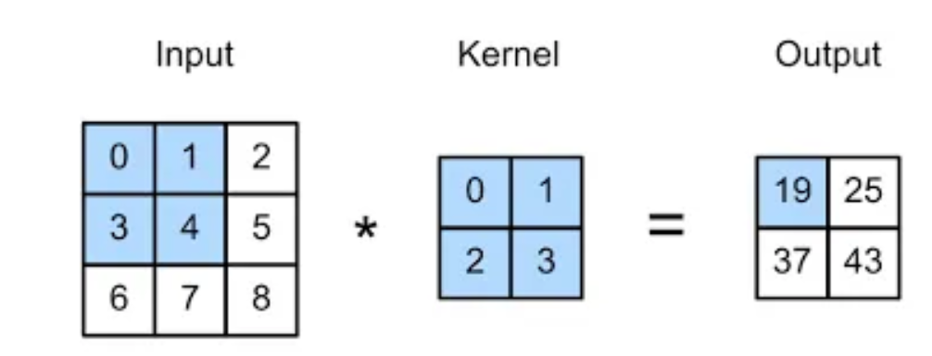
Kernels
(extract information)
Small matrices of numbers.
These filters move across the image performing element-wise multiplication with the part of the image they cover, extracting features such as edges, textures, and shapes.
Convolution Operation The convolution operation involves multiplying the kernel values by the original pixel values of the image and then summing up the results.
This is a basic example with a 2 × 2 kernel:
(0 × 0) + (1 × 1) + (3 × 2) + (4 × 3) = 19
(1 × 0) + (2 × 1) + (4 × 2) + (5 × 3 ) = 25
(3 × 0) + (4 × 1) + (6 × 2) + (7 × 3) = 37
(4 × 0) + (5 × 1) + (7 × 2) + (8 × 3) = 43
The output matrix of this process is known as the Feature map.

Slide 11
Different Types of Kernels
Depending on the desired effect, a kernel may cause different effects on an image.
Blurring: Produces a kernel in which the centered pixels contribute more information than those near the edges.
Sharpening: Produces a kernel that sharpens the image and enhances its acutance.
Embossing: Produces a kernel in which every pixel is replaced either by a highlight or a shadow.
Edge Detection: Produces a kernel that identifies the edges within an image to detect the boundaries of objects in it.

Slide 12
3 components inside convolution Layers are
Channels | Digital images are often composed of three channels (RGB) which are represented in three different matrices There are typically separate kernels for each color channel The ‘depth’ of a layer refers to the number of kernels it contains each producing separate feature map. the collection of these feature maps = complete output of the layer.
Stride | Stride refers to the number of pixels by which a kernel moves across the input image. A larger stride = smaller output dimensions, whereas (control overfitting) a smaller stride = a larger output dimension global features and local features coverage
Padding | the addition of extra pixels around the edge of the input image. Some pixel those at edges are traversed less as compare to those at center of an image. To adjust the spatial size of the output of a convolutional operation and to preserve spatial information at the borders Padding increases the size of the output feature map

Slide 13
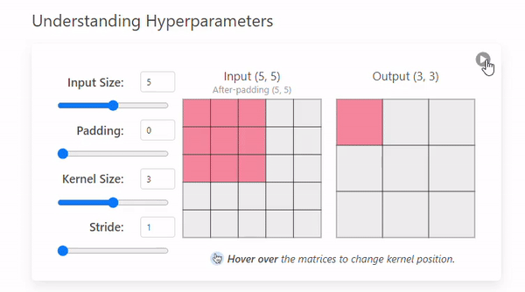
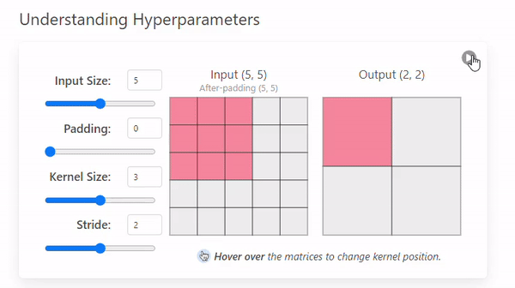
Stride = 1, Stride = 2

Slide 14
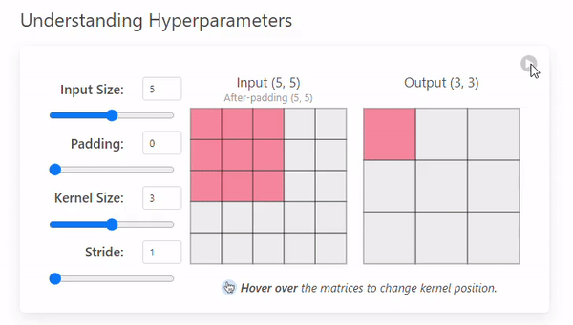
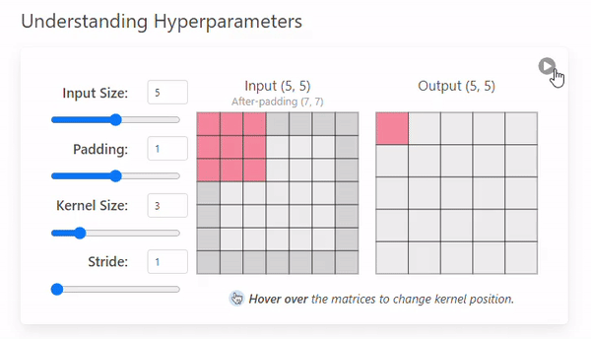
Padding of images
Padding = 0
Padding = 1

Slide 15
Output size of a convolutional layer
“2 × Padding” accounts for padding applied to both the left and right sides (or top and bottom sides) of the input
“+ 1” accounts for the initial position of the filter, which starts at the beginning of the padded input.
Summing up we can say that The main objective of Convolutional Layers is FEATURE EXTRACTION

Slide 16
Pooling Layer
Main objective is indeed dimensionality reduction
It convert a large image to smaller and preserve all the important features like edges and colors.
The pooling layer operates independently on every depth slice of the input.
Using the Max or Average of the values in a window slid over the input data.

Slide 17
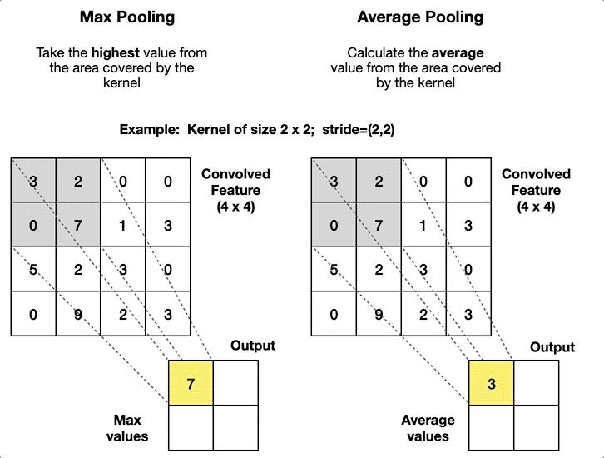
The feature map from (4 × 4) to (2 × 2)

Slide 18
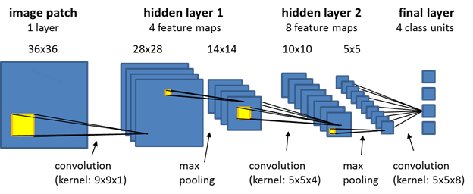
Visualization of CNN operations

Slide 19

Flattening Layers
Convolutional and pooling layers have extracted relevant features from the input image
It takes the entire feature map and reorganizes it into a single, long vector. Reasons
Integration of features
Compatibility with Dense Layers
Use for prediction on basis of extracted features
classifying images, detecting objects, or making predictions based on visual inputs
Need 1-dimensional data(Fully connected layers))
These feature maps need to be converted into a single vector so that the fully connected layers can process them for classification or regression tasks.
connected layers perform high-level reasoning by combining features. They require inputs as a 1D vector for computations.

Slide 20

Activation Layer

Slide 21
